Slide 1
Java Messaging Queue Active MQ Spring Integration

Slide 2
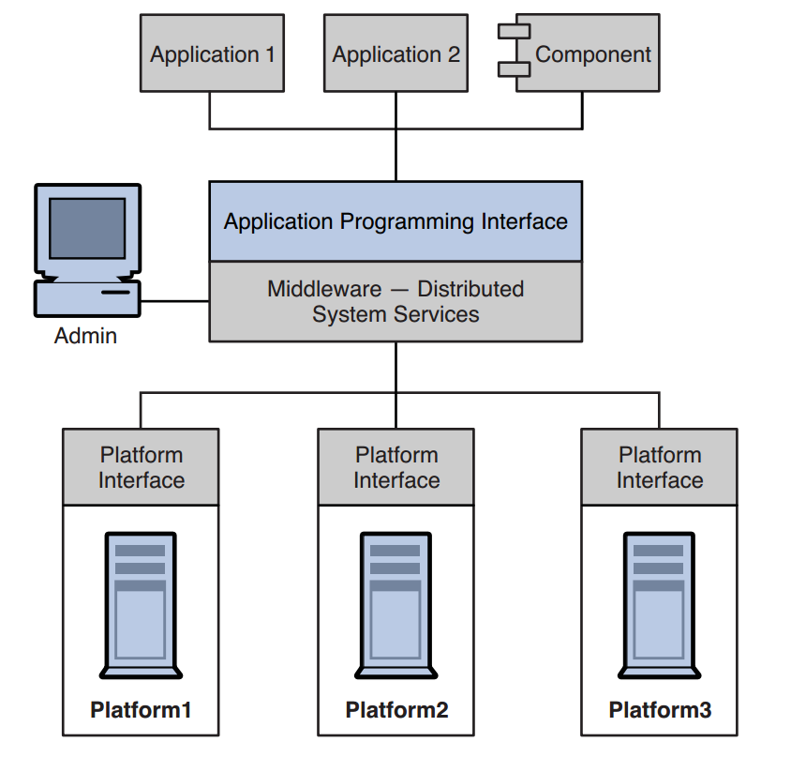
Middleware
Middleware allows software components that have been developed independently and that run on different networked platforms to interact with one another
Remote Procedure Call (RPC)
Object Request Broker (ORB)
Message Oriented Middleware (MOM)

Slide 3
Messaging
Communication between software components or applications
Enables distributed communication that is loosely coupled
JMS – Java Message Service
Java API
Create, send, receive, and read messages

Slide 4
Java Message Service
Enables communication that is:
Asynchronous – to receive the message, the client is not required to send a request
Reliable – provides assurance that the message is delivered
When do you use it?
You don’t want components to depend on information about other components
You want the application to run whether or not all components are up and running simultaneously
Component can send info to another and continue to operate without an immediate response

Slide 5
JMS API Architecture
JMS application has the following parts
JMS Provider – implements the JMS interfaces, provides control features
JMS Clients – the programs/components that produce and consume messages
Messages – the objects that communicate information between the clients
Administered Objects – preconfigured objects the clients use (destinations and connection factories)

Slide 6
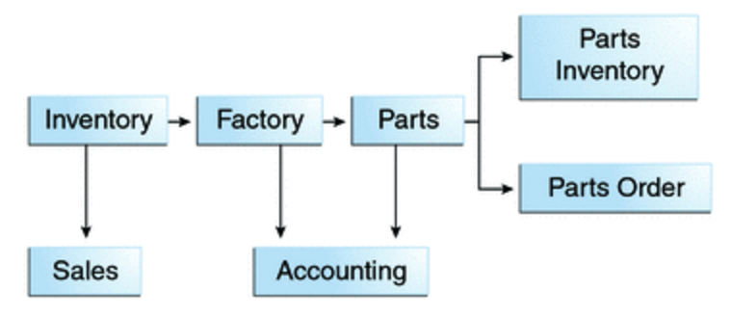
Example – An Enterprise Application

Slide 7
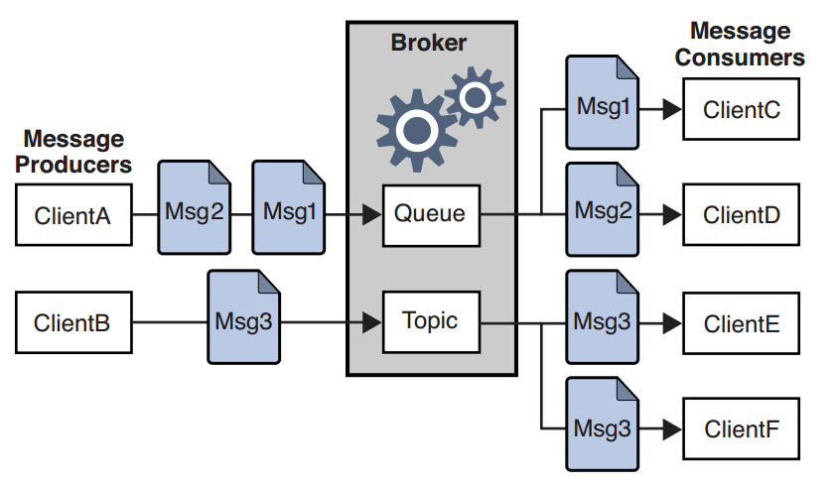
Messaging Domains – First Type
Point-to-Point Messaging Domain
Using this pattern, a client sends a message to a queue destination from which only one receiver may get it.
No other receiver accessing that destination can get that specific message.

Slide 8
Messaging Domains – Second Type
Publish/subscribe Domain
Using this broadcast pattern, a client sends a message to a topic destination from which any number of consuming subscribers can retrieve it.
Each subscriber gets its own copy of the message.

